Slide 1
Introduction

Slide 2
Network Administration?

Slide 3
Workstations
A workstation is a client computer that is used to run applications and is connected to a server from which it obtains data shared with other computers.
A workstation is a special computer designed for technical or scientific applications. Intended primarily to be used by one person at a time, they are commonly connected to a local area network and run multi-user operating systems.

Slide 4
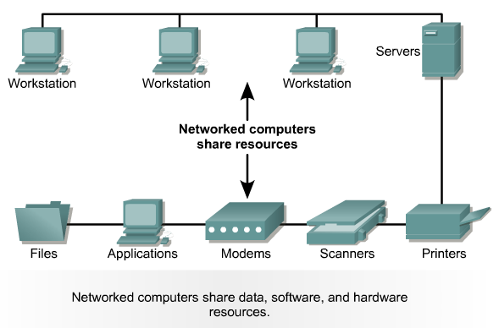
Servers: Connecting Computer Systems

Slide 5
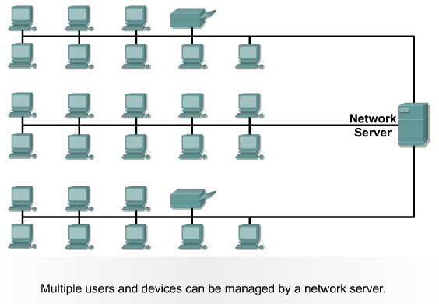
Network Server Environment

Slide 6
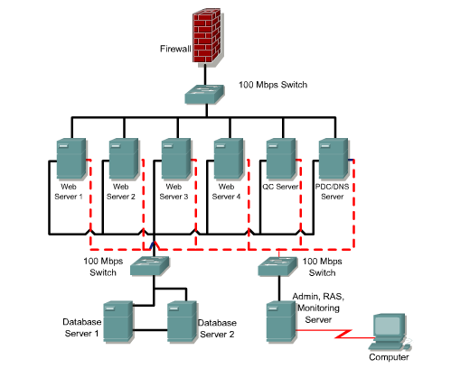
Server Farm

Slide 7
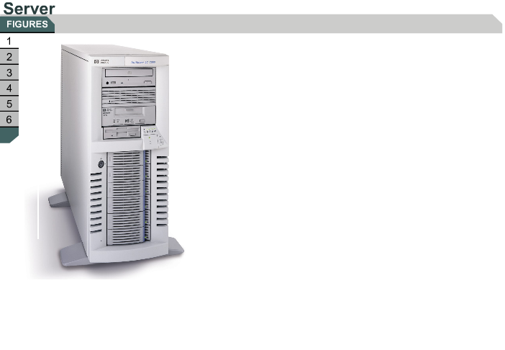
6.1.2 Servers
Hypertext Transfer Protocol (HTTP)
File Transfer Protocol (FTP)
Domain Name System (DNS)
Simple Mail Transfer Protocol (SMTP)
Post Office Protocol 3 (POP3)
Internet Messaging Access Protocol (IMAP)
File sharing protocols include Sun Microsystems Network File System (NFS)
Microsoft Server Message Block (SMB).
Print services
Dynamic Host Configuration Protocol (DHCP)
Firewall: Proxy or Network Address Translation (NAT)
Some Windows operating systems may be installed on both workstations and servers.
The NT/2000/XP versions of Windows software provide network server capability.

Slide 8
Private Network
• Private IP network is an IP network that is not directly
connected to the Internet
• IP addresses in a private network can be assigned arbitrarily.
– Not registered and not guaranteed to be globally unique
• Generally, private networks use addresses from the following
experimental address ranges (non-routable addresses):
– 10.0.0.0 – 10.255.255.255
– 172.16.0.0 – 172.31.255.255
– 192.168.0.0 – 192.168.255.255

Slide 9
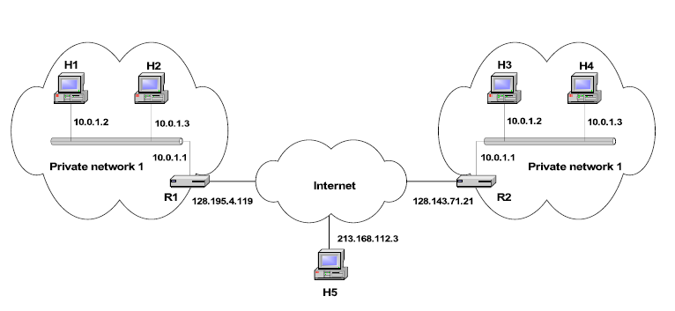

Slide 10
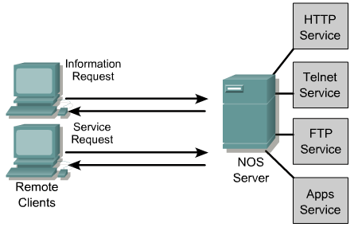
Client-Server Interaction

Slide 11
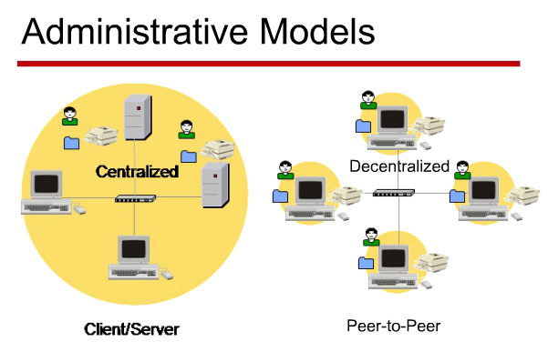

Slide 12
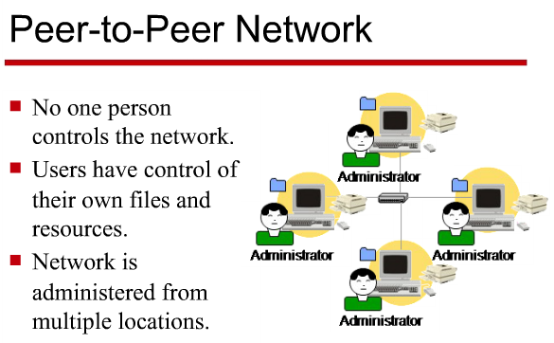

Slide 13
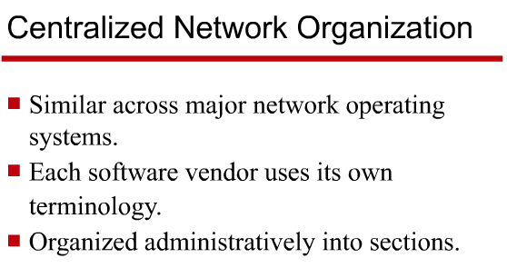

Slide 14
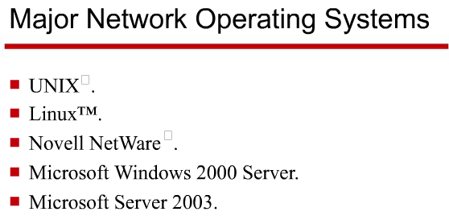

Slide 15
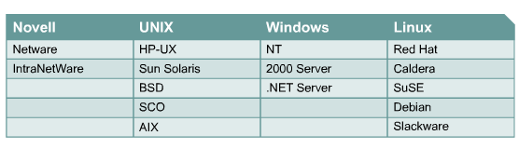
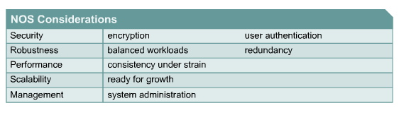
Network Operating Systems

Slide 16
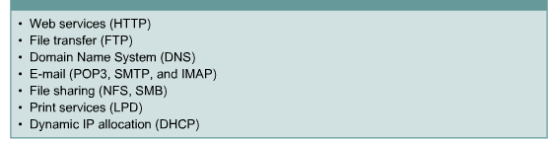
Service Applications and Protocols

Slide 17
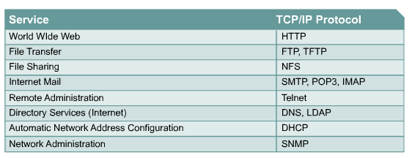
TCP/IP Based Services

Slide 18
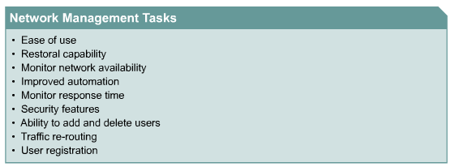
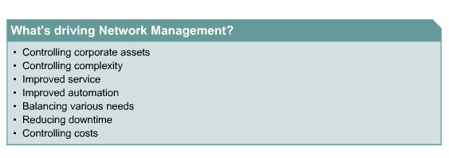
Network Management Requirements

Slide 19
IoT and Networking
There are four main components of an IoT system:
The Thing itself (the device)
The Local Network; this can include a gateway, which translates proprietary communication protocols to Internet Protocol
The Internet
Back-End Services; enterprise data systems, or PCs and mobile devices

Slide 20
